Slide 1
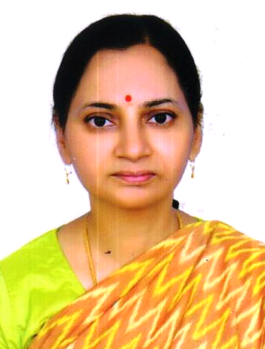
Dr. M. Alimelu, MD, DNB Professor and HOD
Neonatology Department
Niloufer Hospital
Osmania Medical College
Hyderabad
She has been in Government service since 1999
Professor of Pediatrics, Institute of Mother & Child health, Niloufer hospital, Osmania Medical College since 2016
Professor & HOD, Department of Neonatology since 2020
Over 23 years of teaching experience, examiner for MD Pediatrics & DM Neonatology university exams

